Slide 1


Slide 2


Slide 3
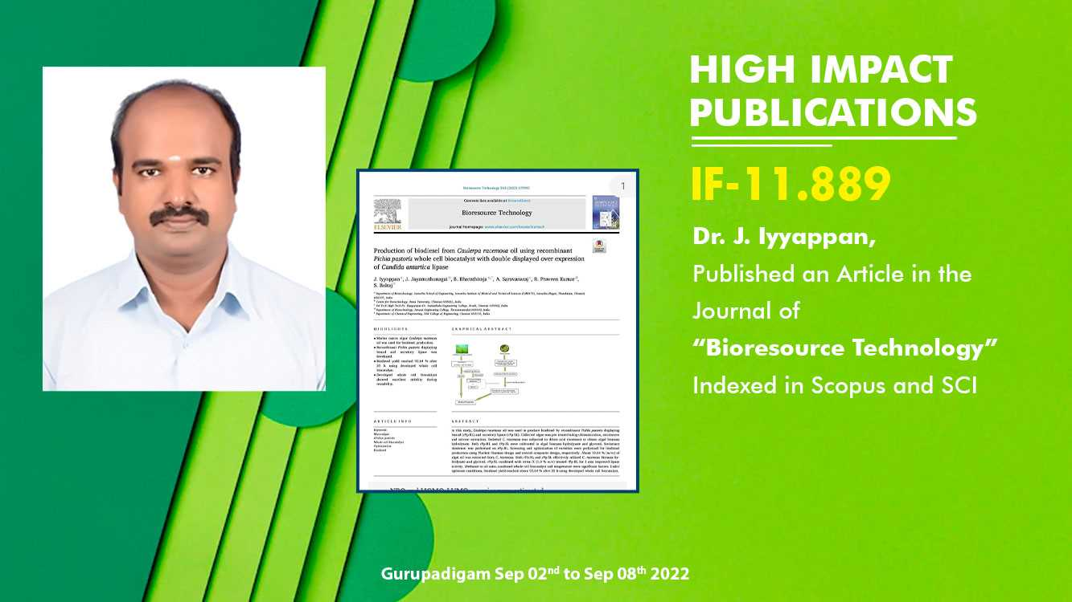

Slide 4
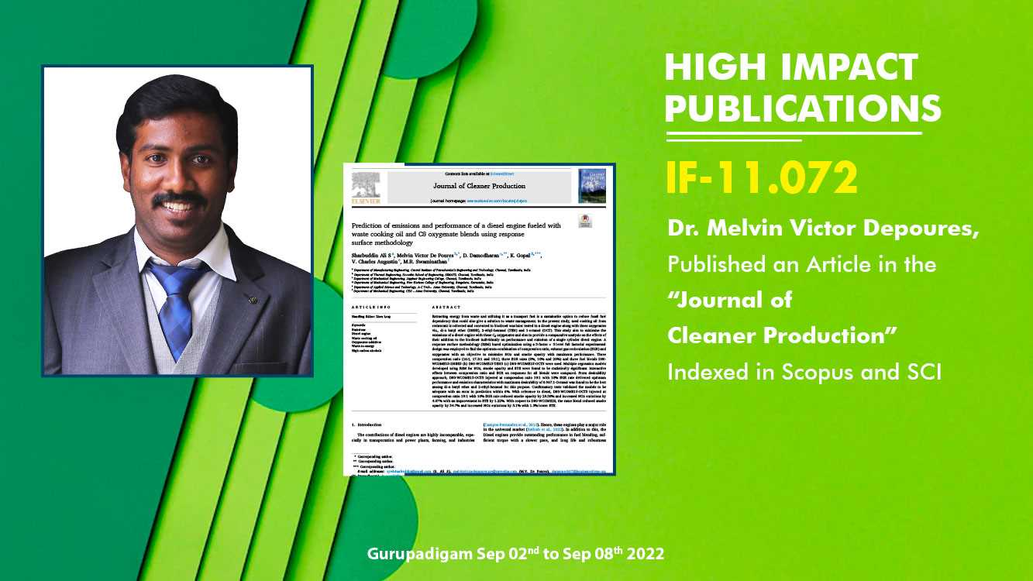

Slide 5
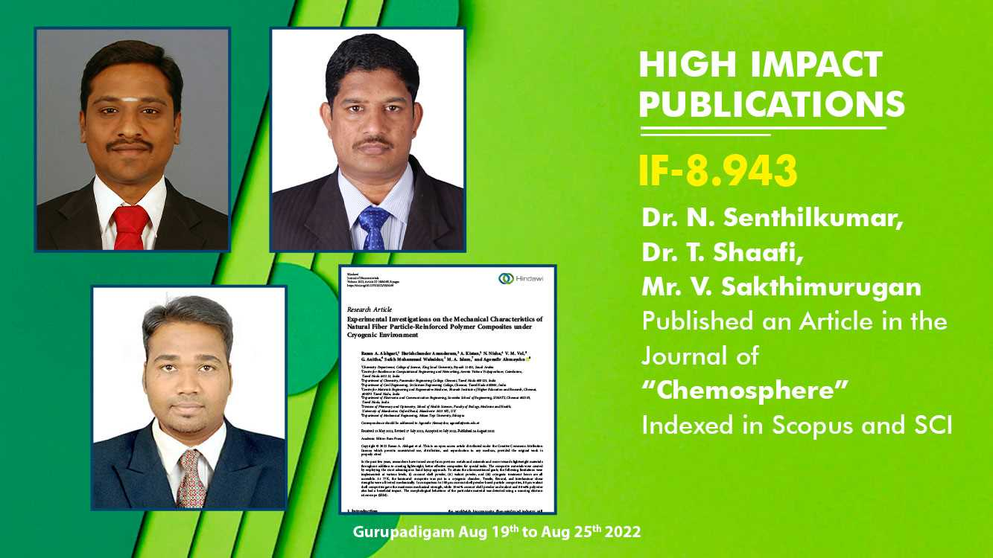

Slide 6
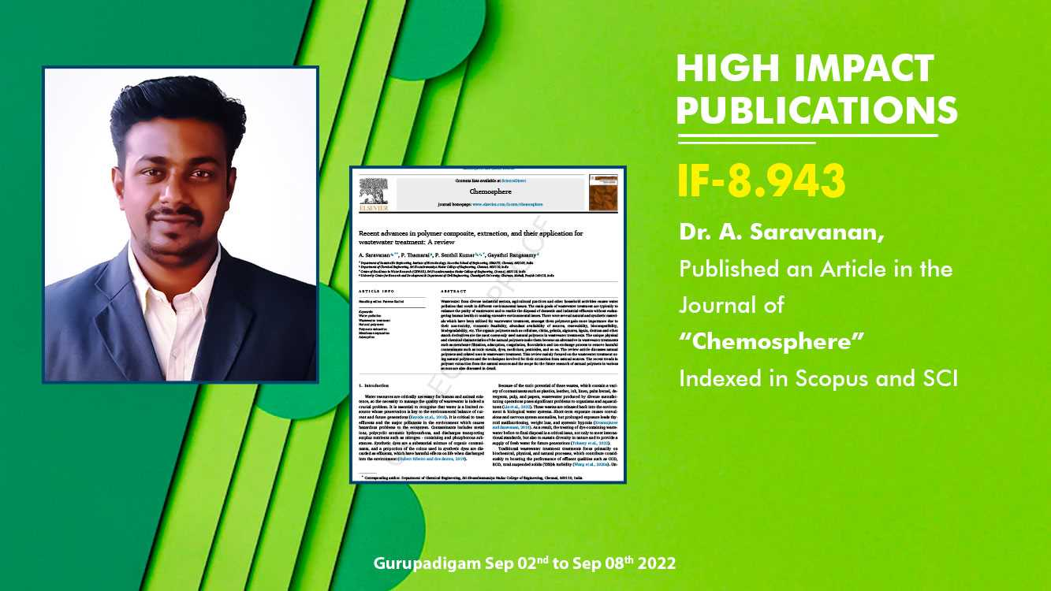

Slide 7
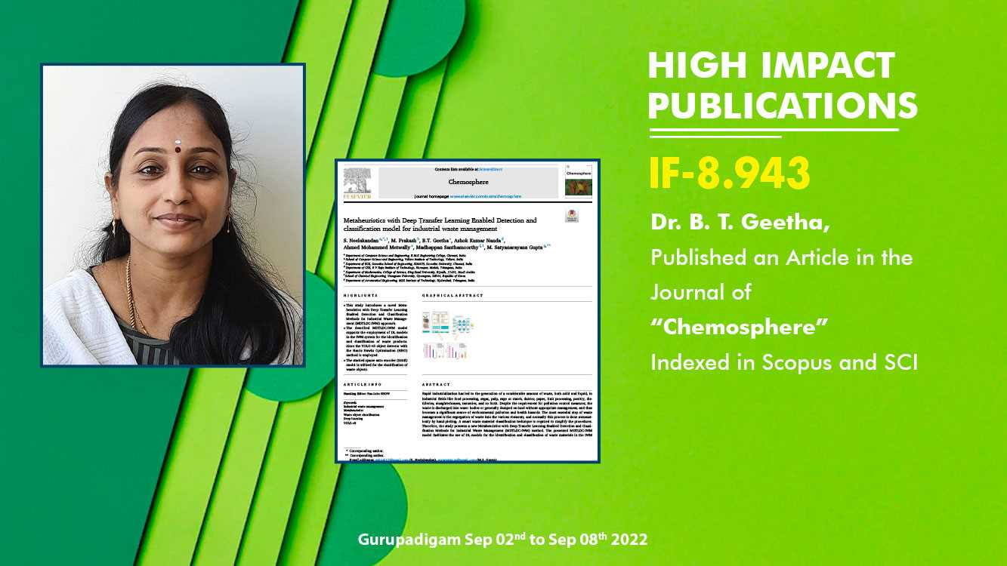

Slide 8
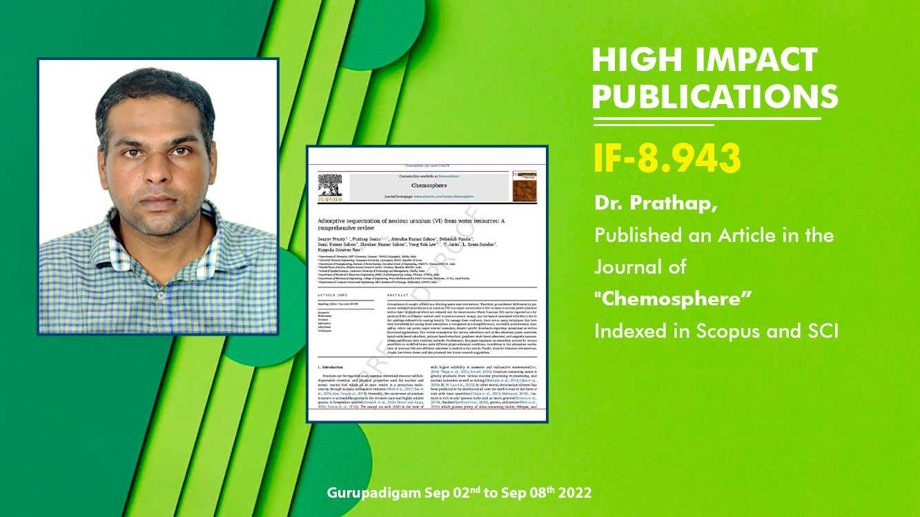

Slide 9
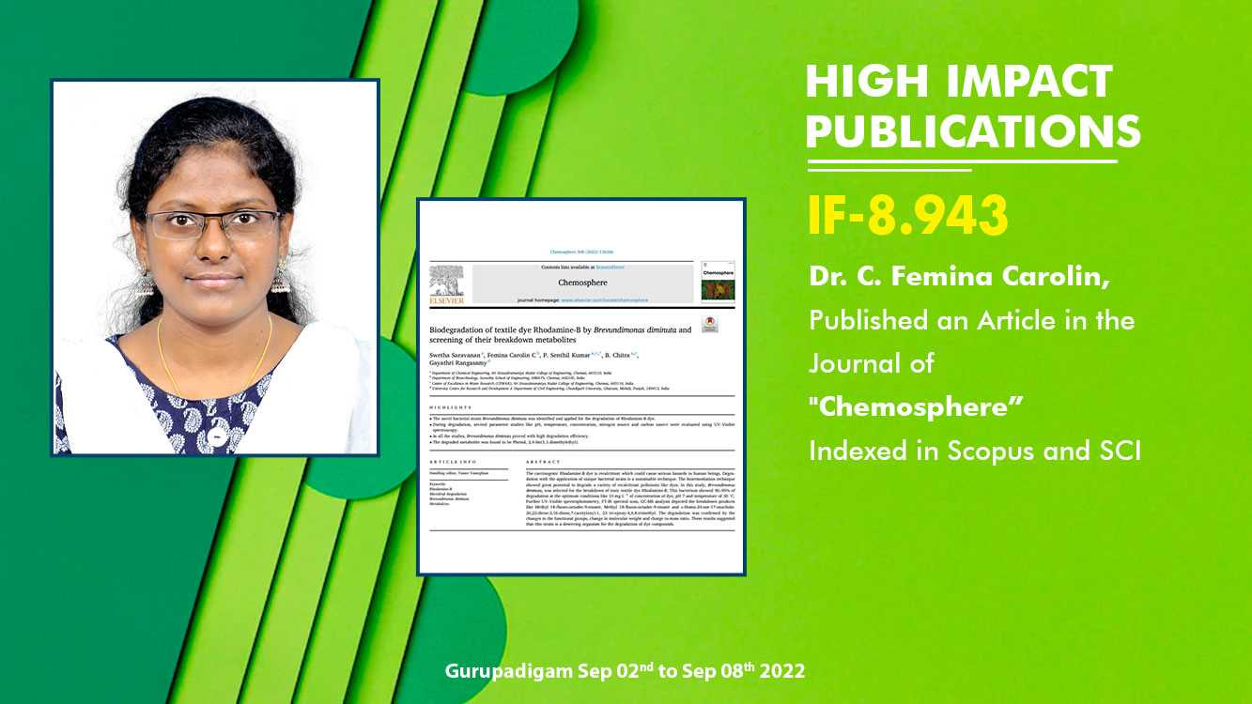

Slide 10
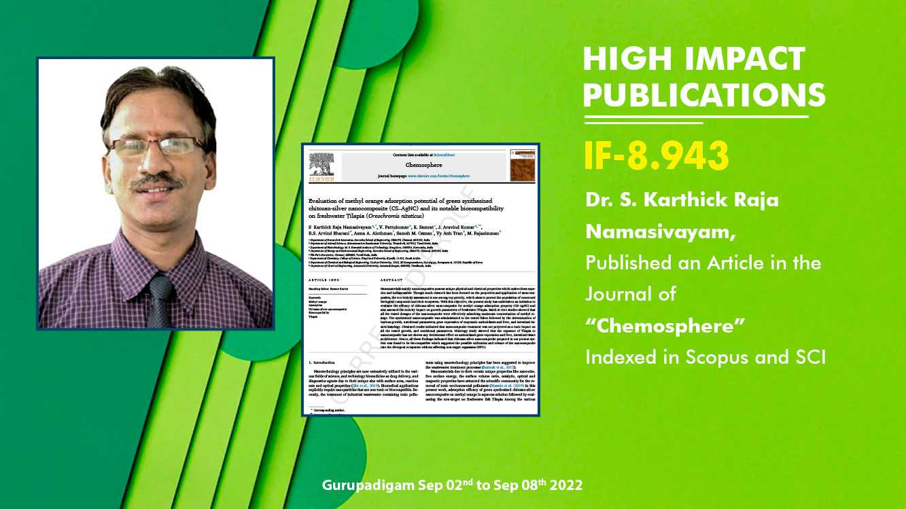

Slide 11
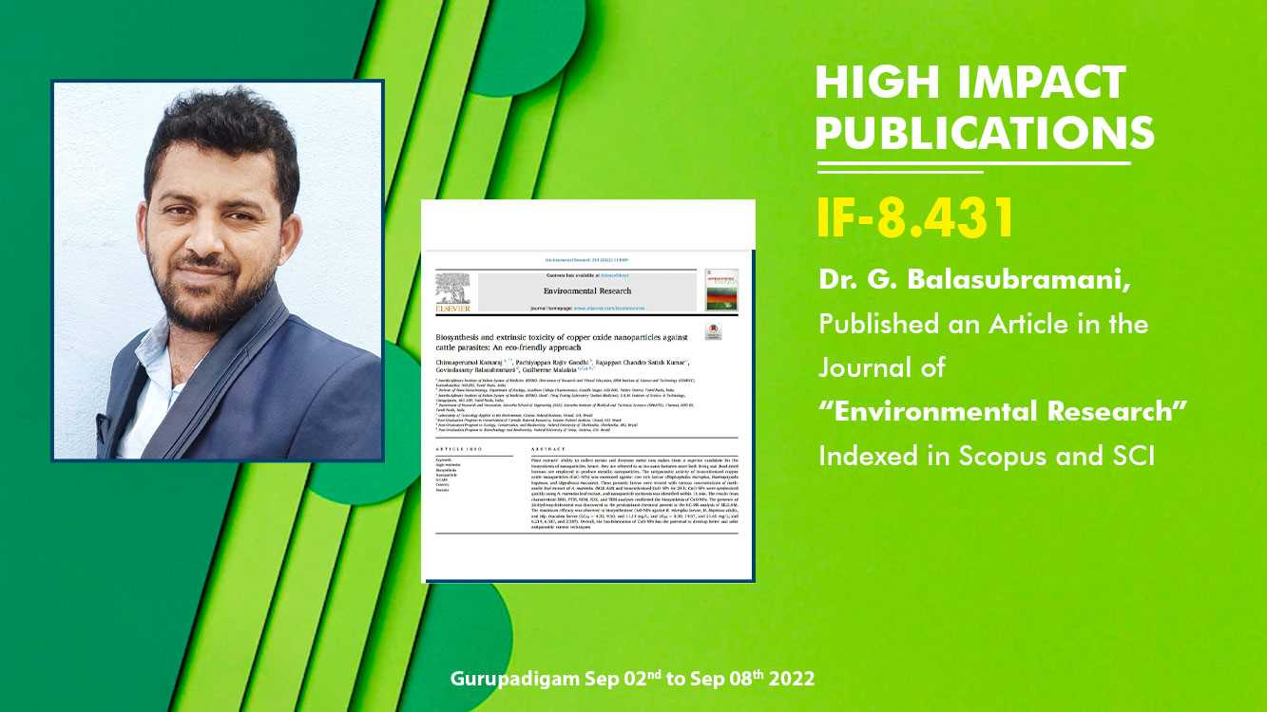

Slide 12
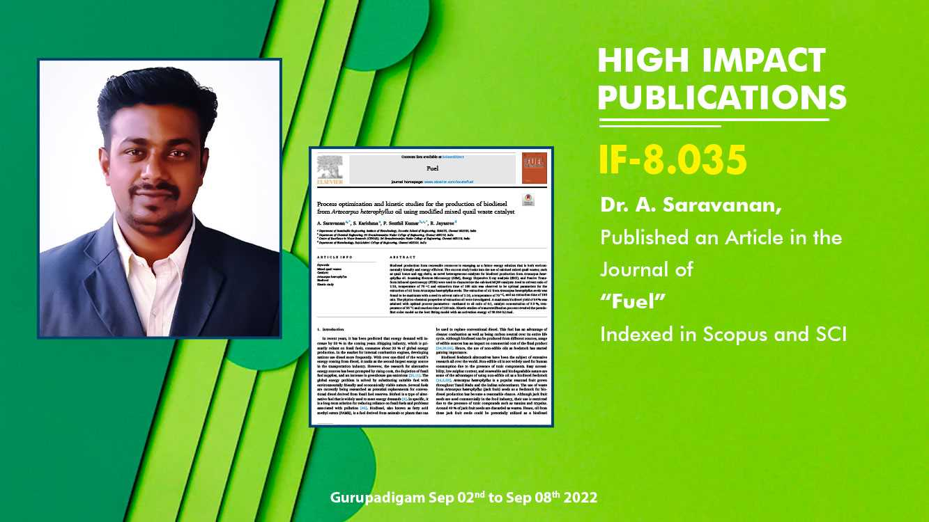

Slide 13
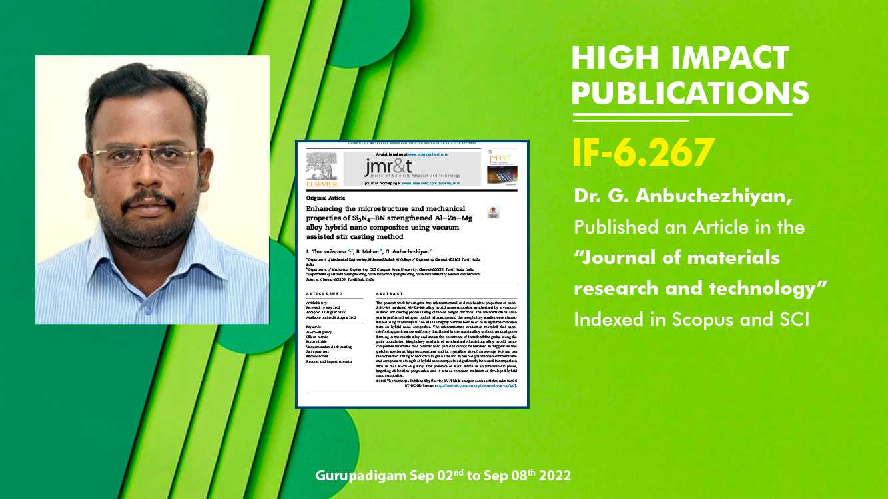

Slide 14
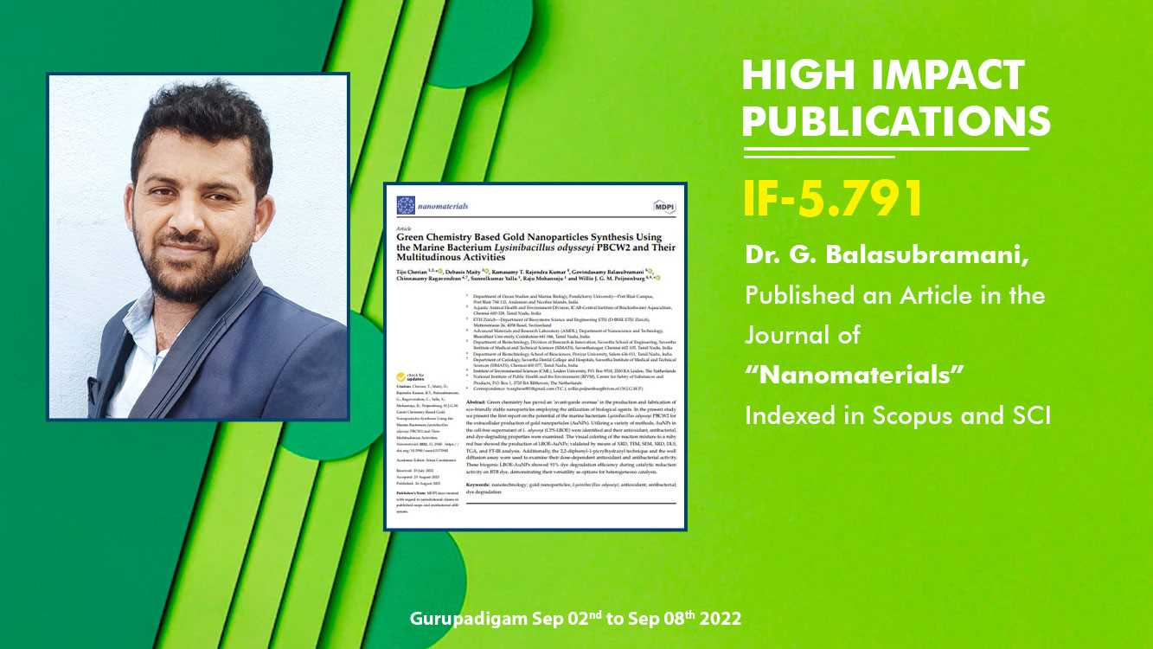

Slide 15
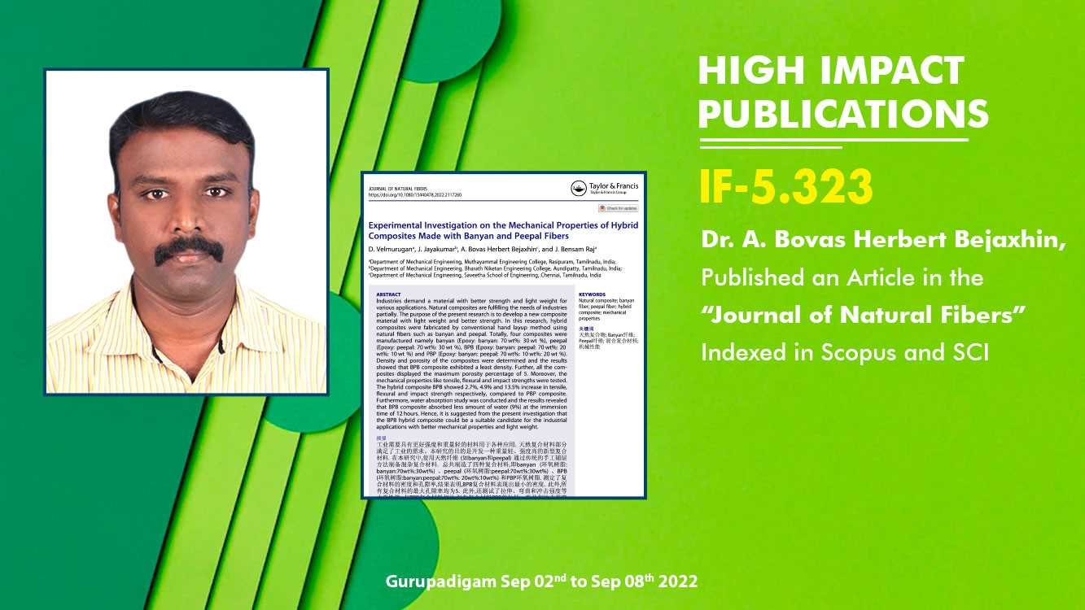

Slide 16
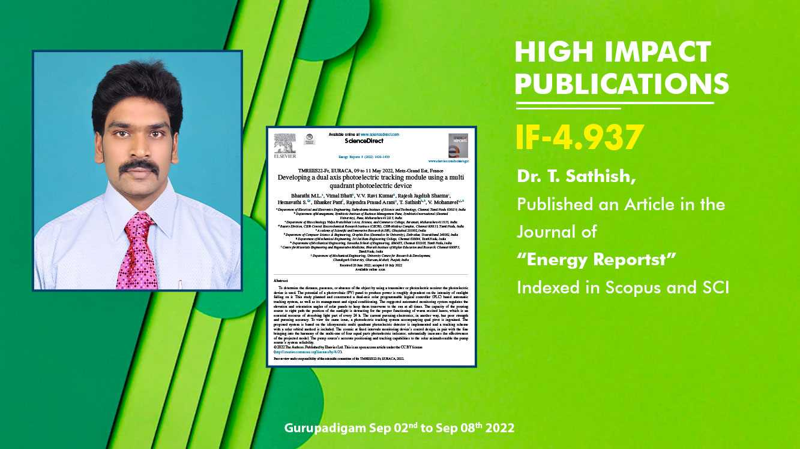

Slide 17
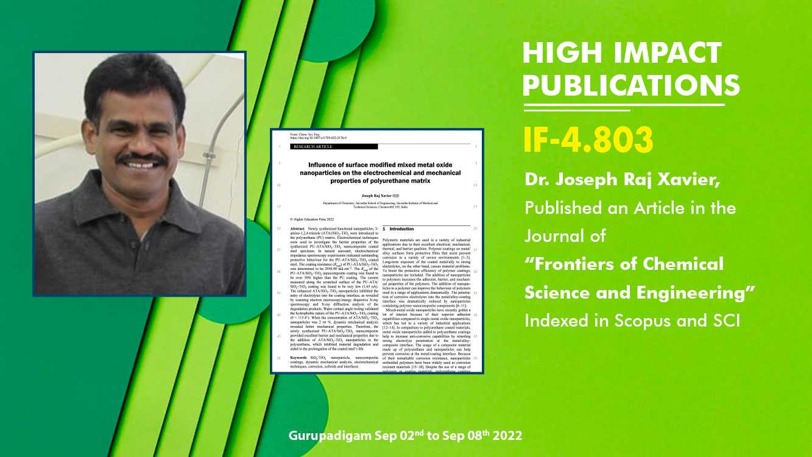

Slide 18
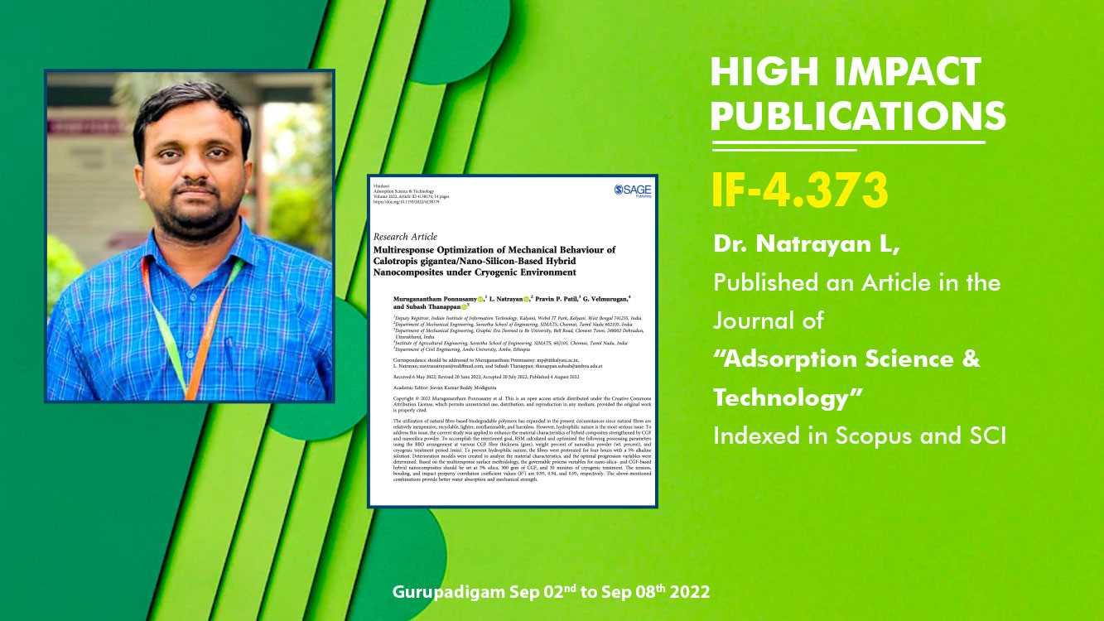

Slide 19
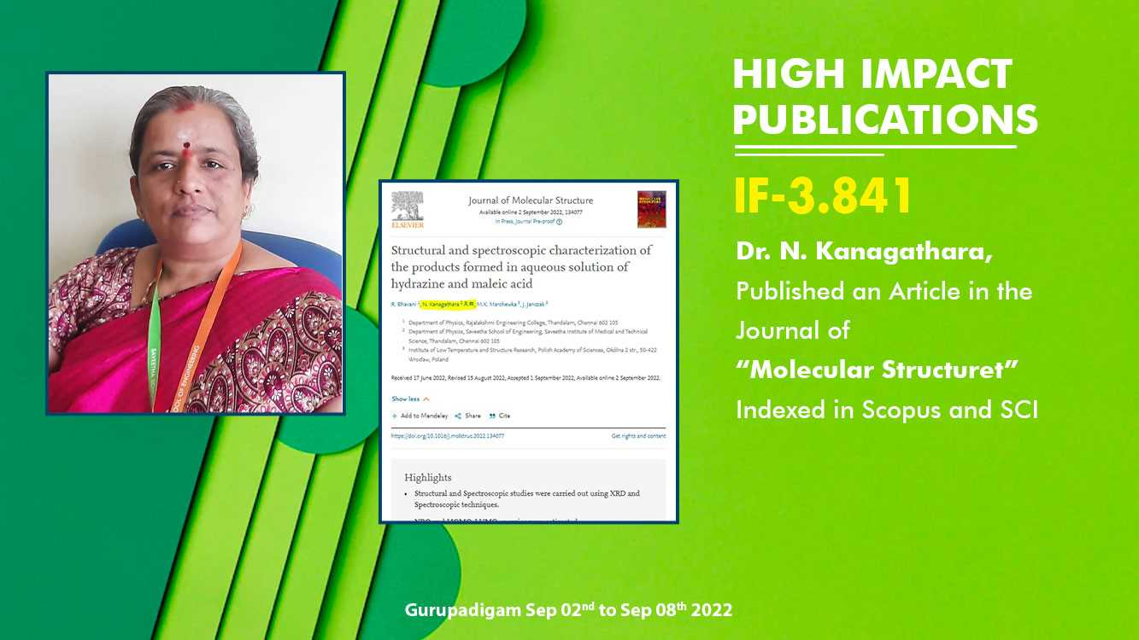

Slide 20
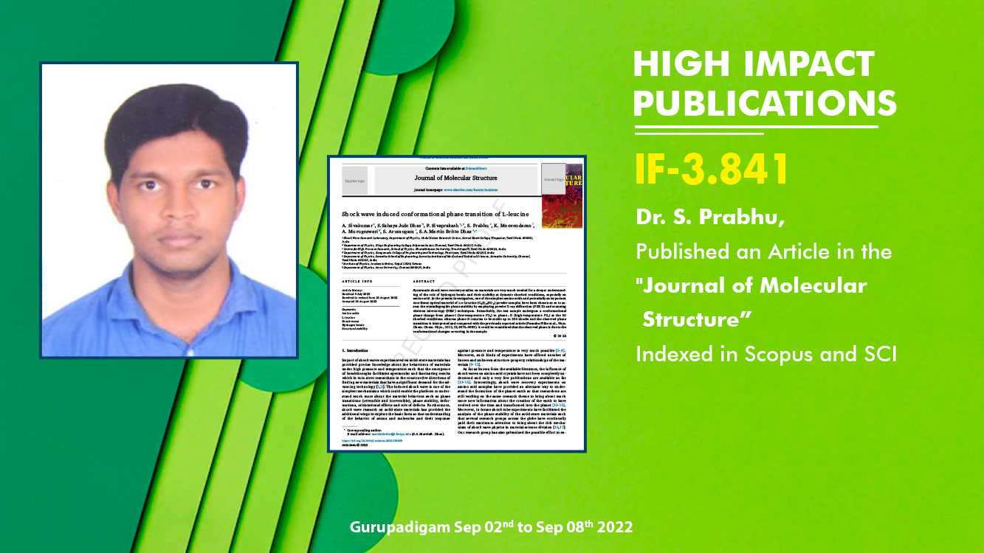

Slide 21
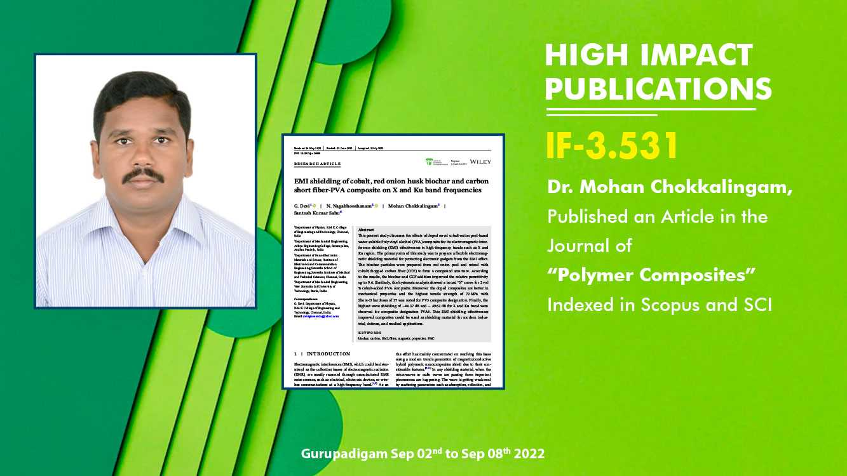

Slide 22
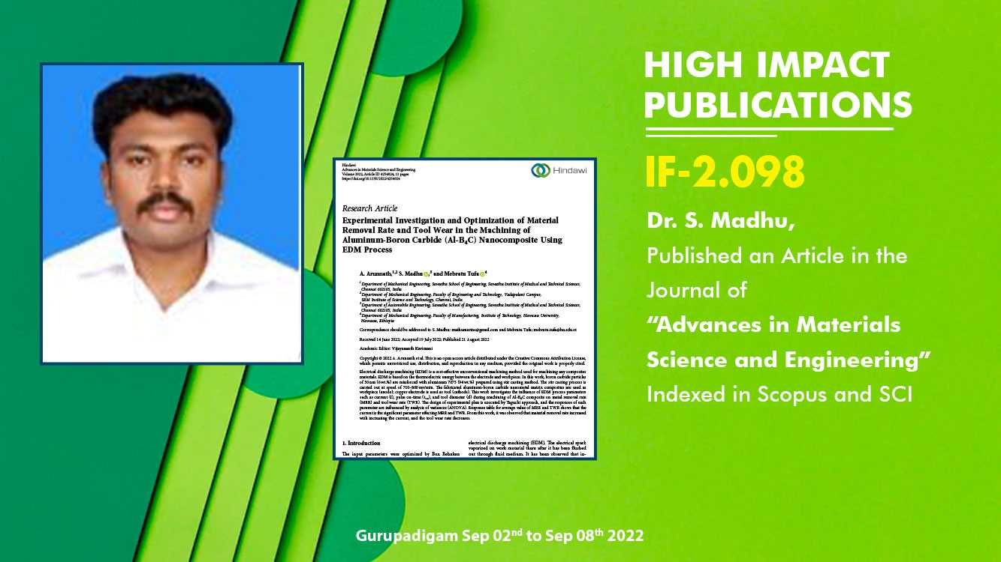

Slide 23
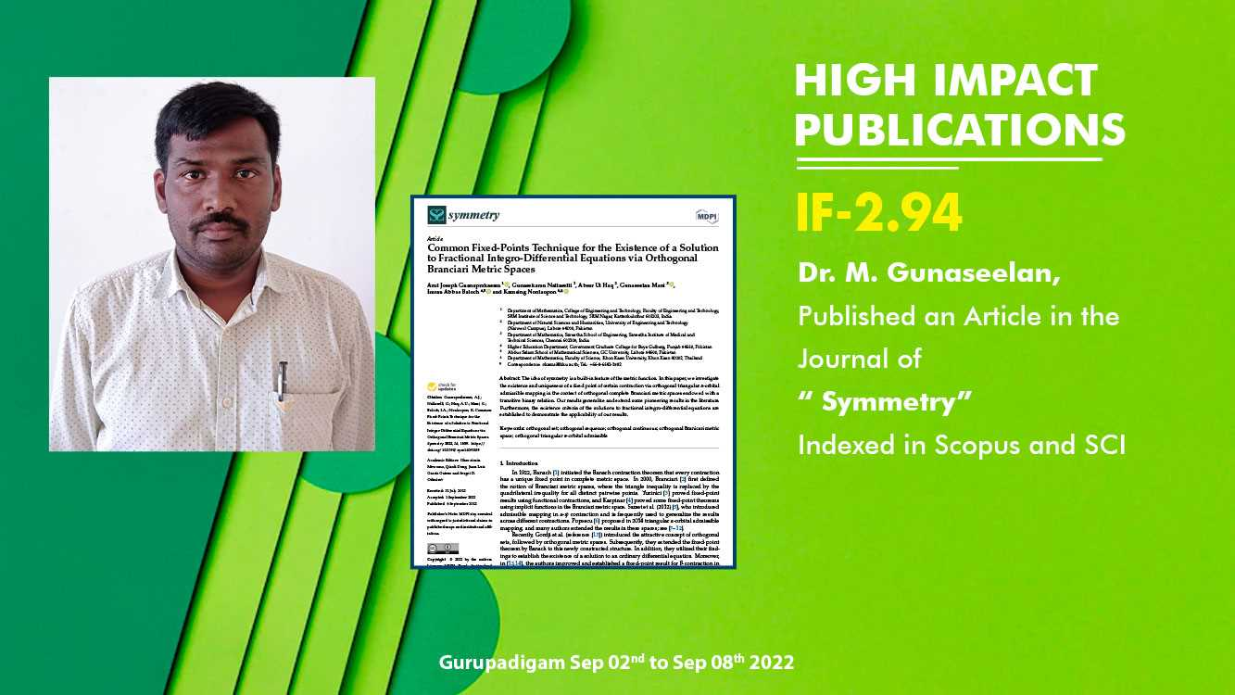

Slide 24
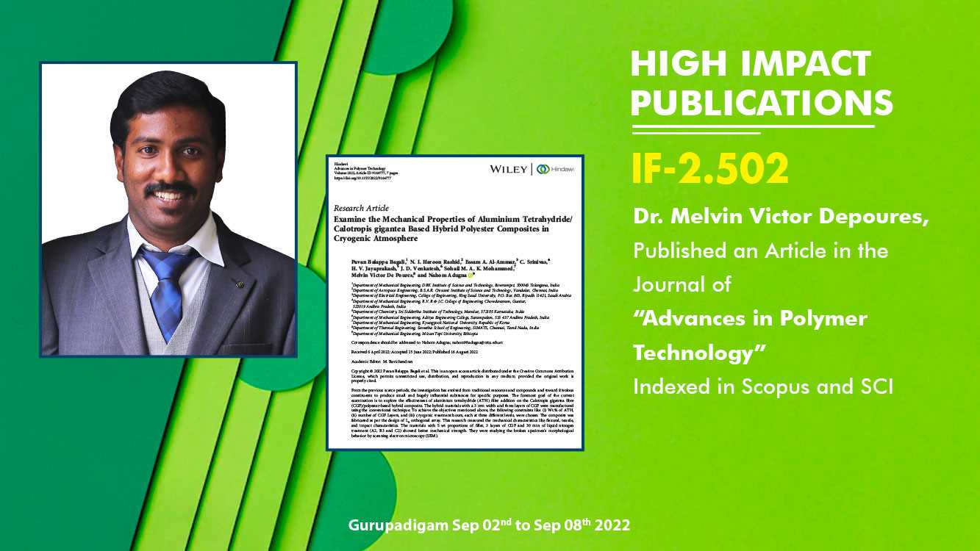

Slide 25


Slide 26
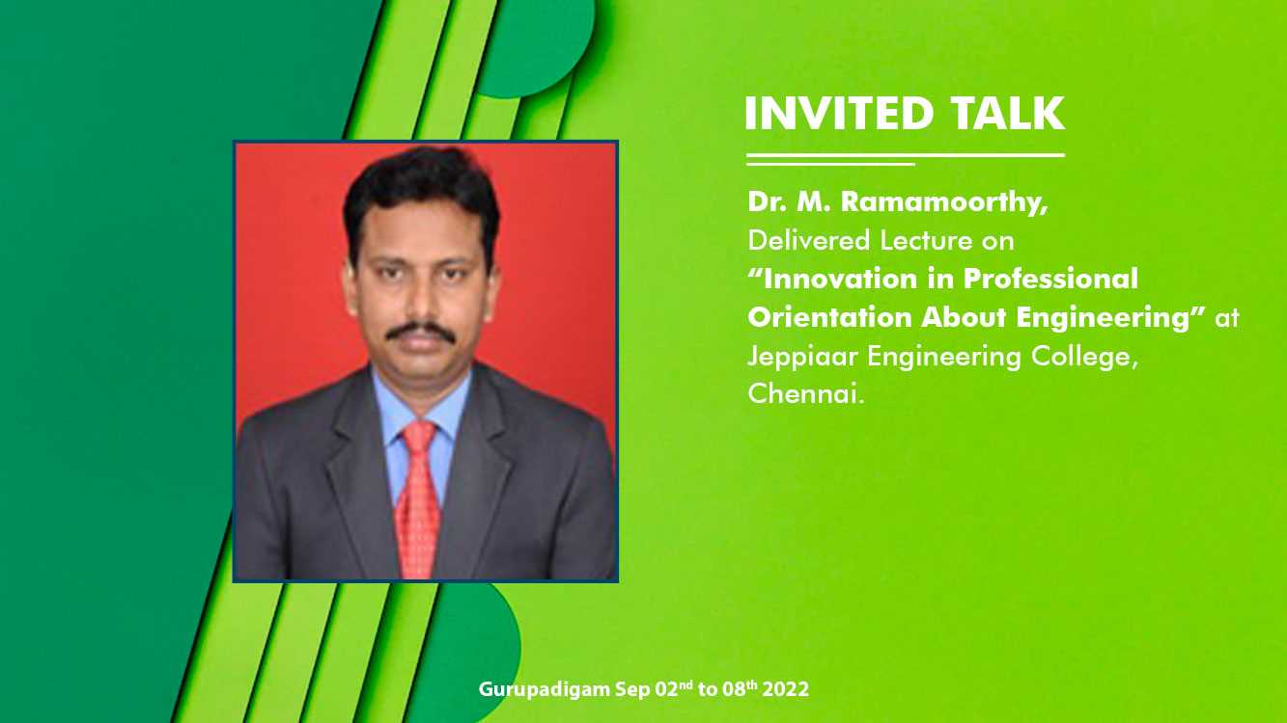

Slide 27
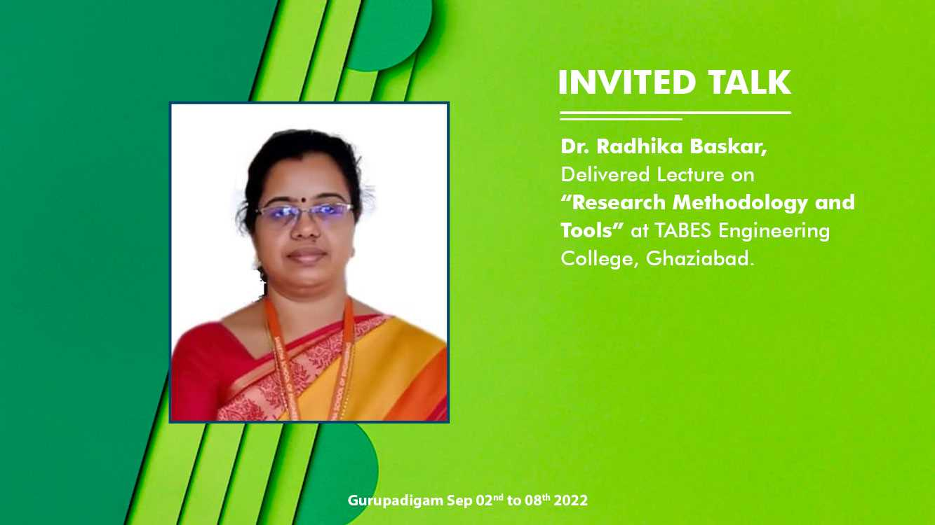

Slide 28
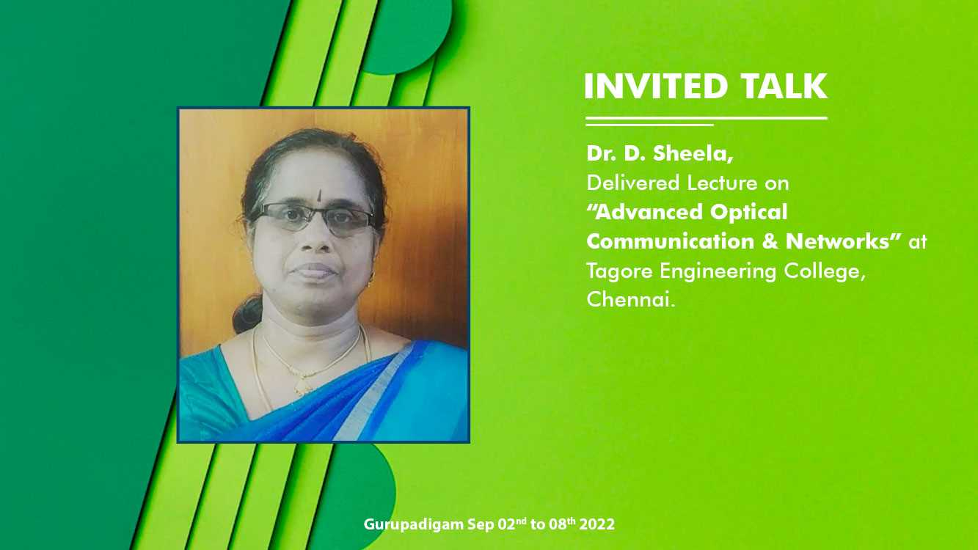

Slide 29


Slide 30
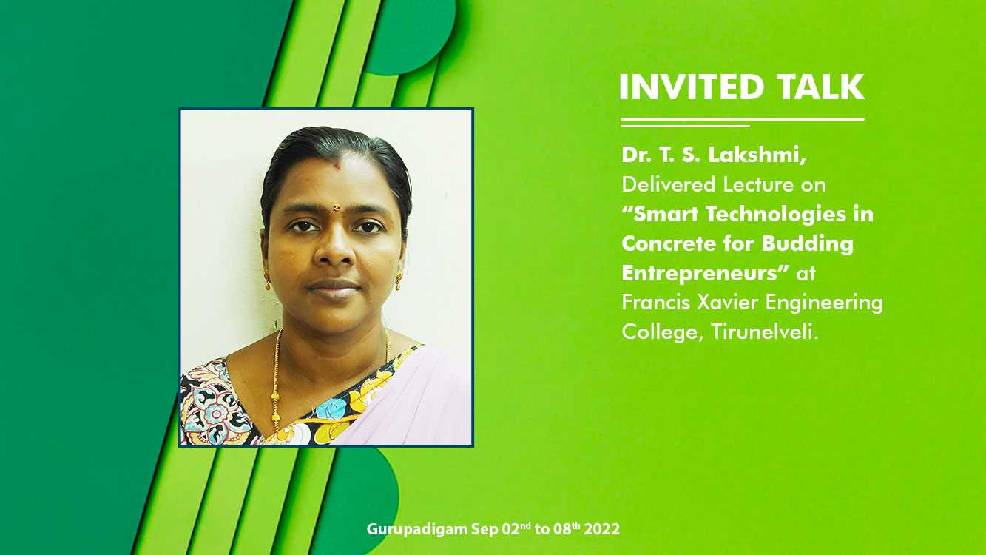

Slide 31


Slide 32
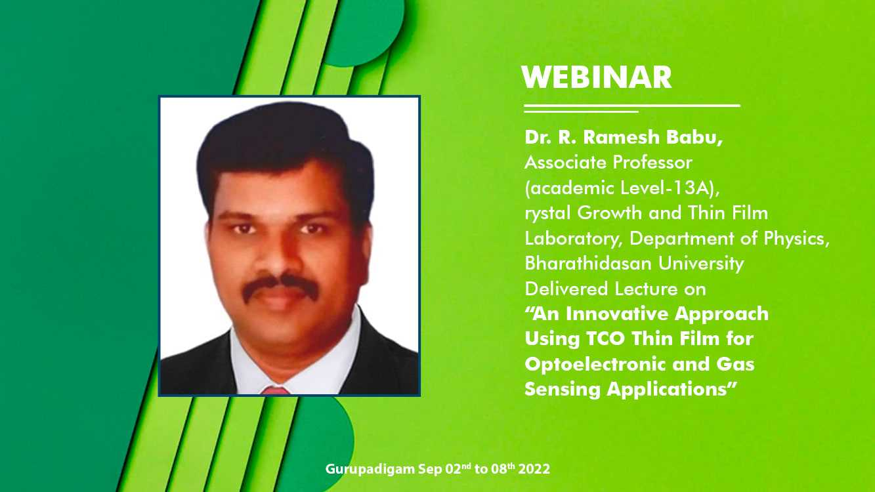

Slide 33
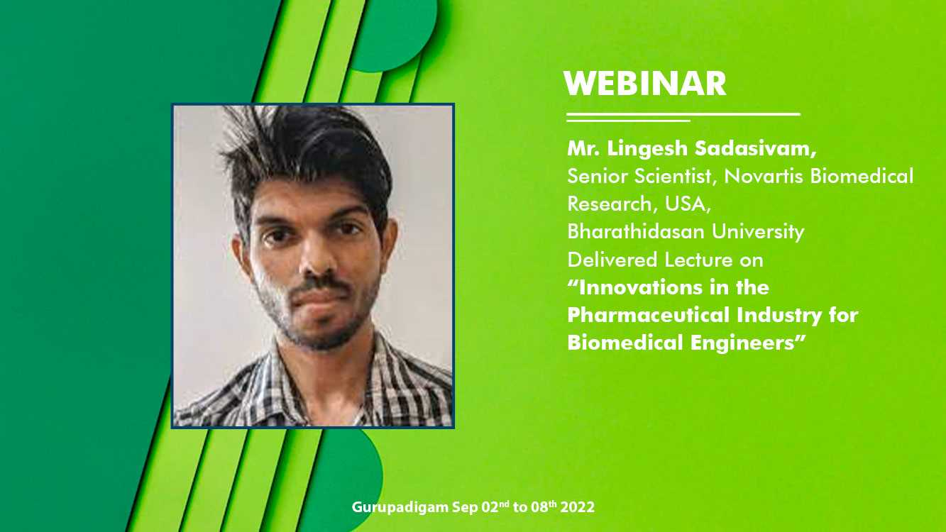

Slide 34


Slide 35


Slide 36


Slide 37
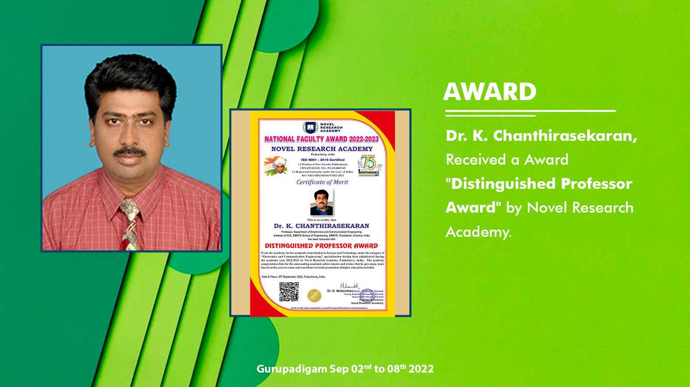

Slide 38
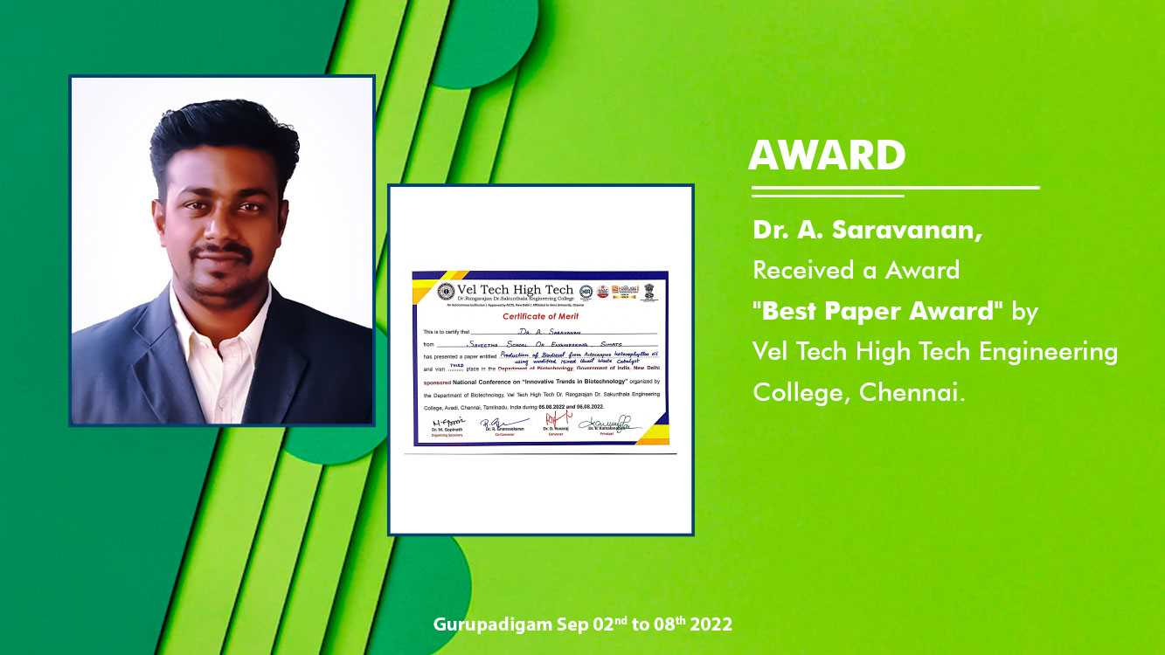

Slide 39


Slide 40
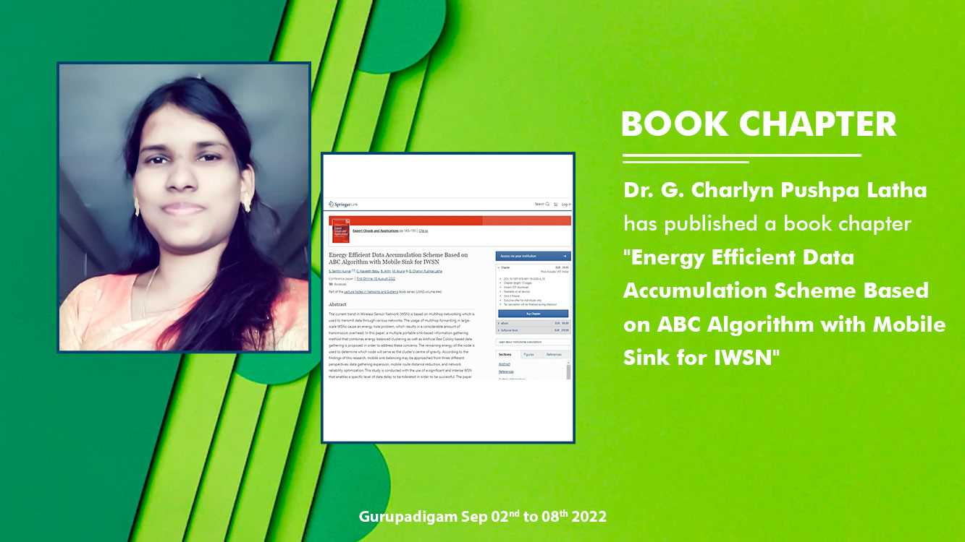

Slide 41


Slide 42
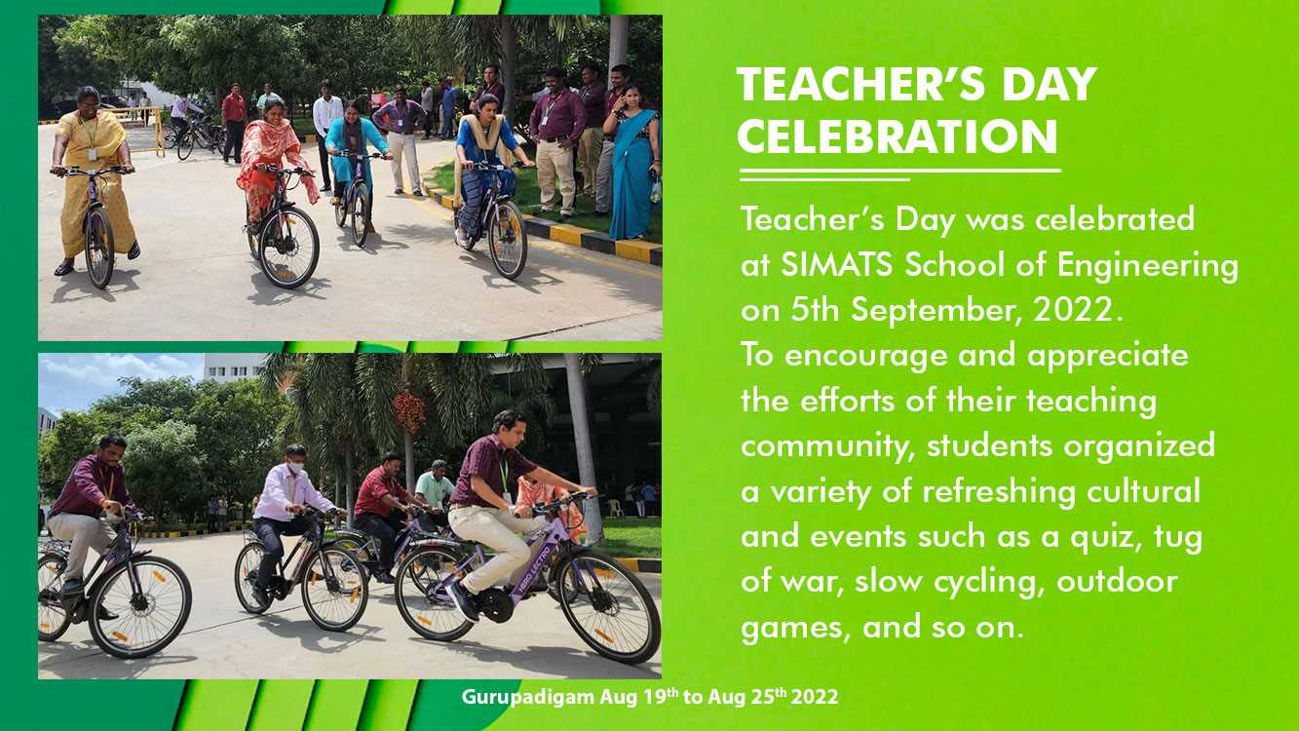

Slide 43
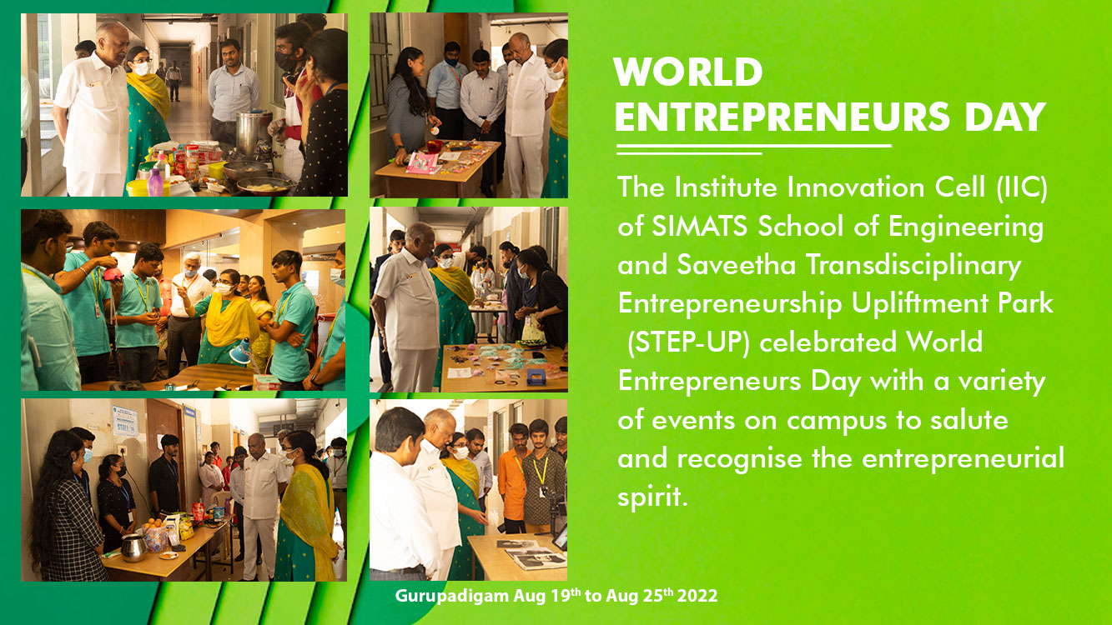

Slide 44

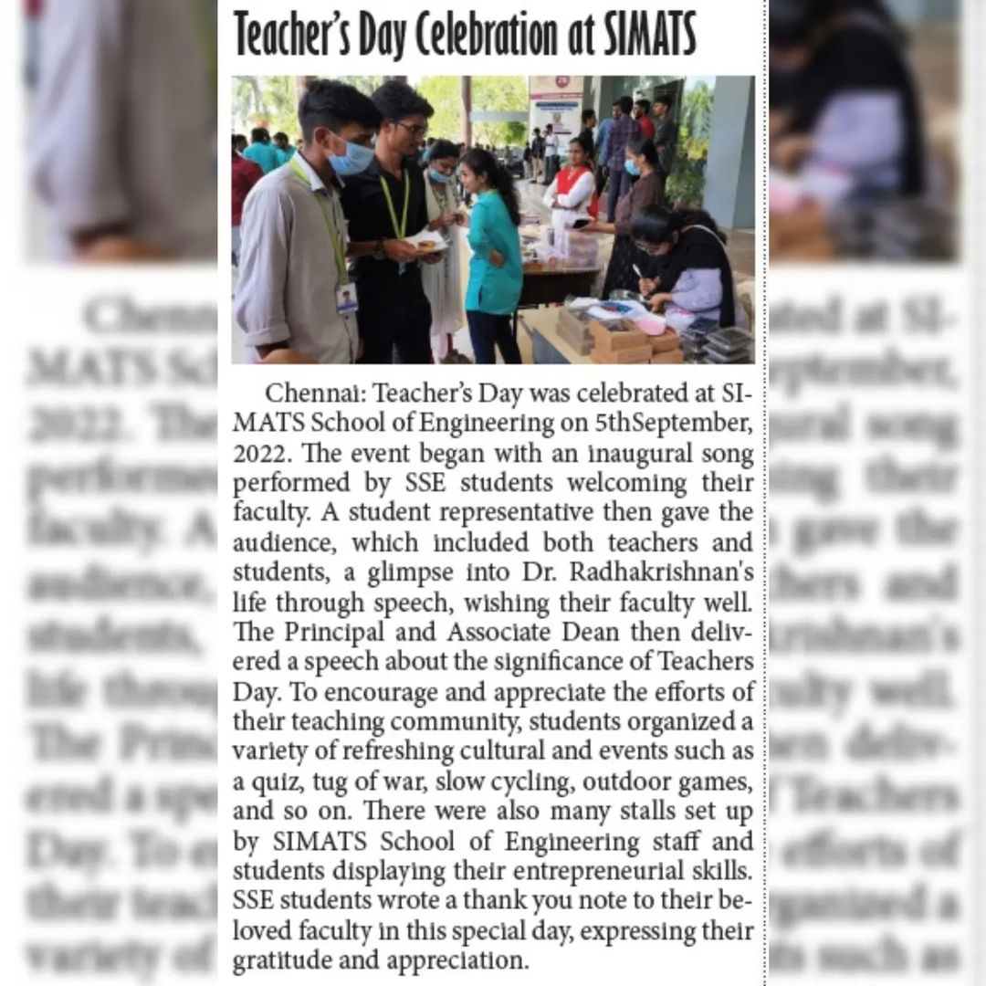
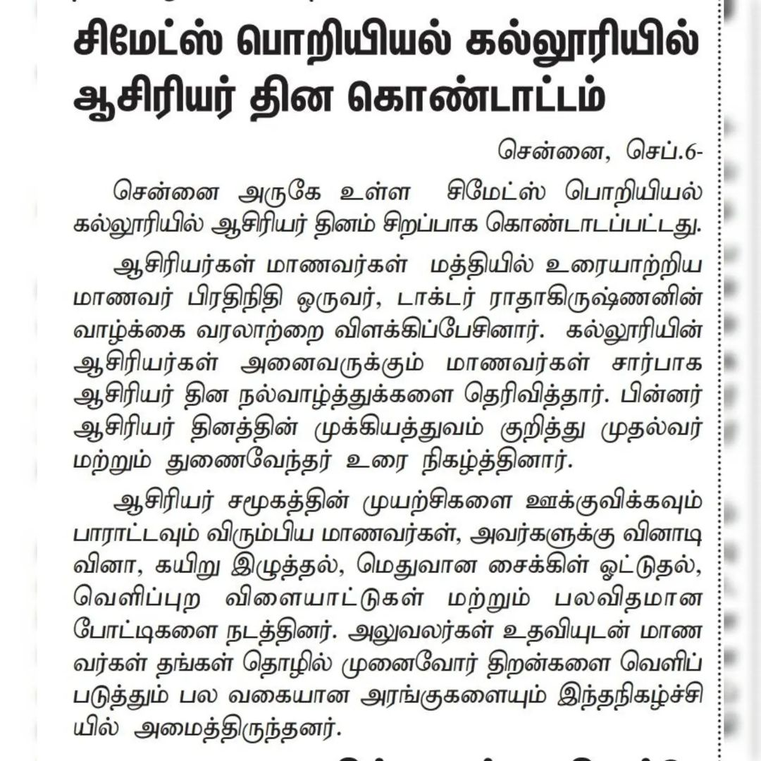

Slide 45
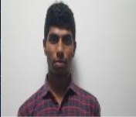
VEERANKI VAMSI KRISHNA
192111311
CSE
Second Year
Course Details & Attendance Percentage
SLOT A: Computer Network for Enhancing Security-100%
SLOT B: Microprocessors and Microcontrollers for Process Control Devices-88%
SLOT C: Database Management Systems for Oracle System-100%
SLOT D: Operating Systems For Linux Administration-100%

Slide 46
EXAM RESULTS
Slot D | Total Marks | Marks Obtained | Class Average Mark
Test 1 | 25 | 13 | 15.43
Test 2 | 25 | 18 | 15.81
Test 3 | 25 | 22 | 17.70

Slide 47
Dear Parent,
Vamsi Krishna is an inquirer. He got 100% attendance in slot-D this week. I appreciate him. He has scored average marks on daily tests, capable of more. His slotD faculty said It would be appreciable if he comes in proper dress code and clean shave. He is obedient and behaves politely in class. His performance in the class is Good. Still, he can do better. He was present for the mentor meeting, conducted on 10.09.2022. Kindly find his revised class timing given below-
8.00 Attendance,
8.10 to 8.40 am Daily test,
8.40 am to 11.00 am. ( Analytical questions, gate questions and others),
11.00 AM to 12.00 AM Lab,
Lunch Break : 12.00 to 1 PM,
1.00 PM to 3.00 PM continue Lab
.

Slide 48
MENTEE RESPONSE
PARANTS RESPONSE
text
text

